Slide 1
L.A. Crimes
What factors can help distinguish between different types of crime?
Shrusti Jain, Kevin Lu, Taobo Liao, Smeet Patel

Slide 2

Roadmap
1
2
3
Motivation
Technical Details
Conclusions
Shrusti Jain, Kevin Lu, Taobo Liao, Smeet Patel

Slide 3

Motivation
Understand motivating features of crimes
Feature importance as a proxy for distinguishing between crimes
Part 1 vs Part 2 (more important vs less important) crimes
Check stability of features over time
Shrusti Jain, Kevin Lu, Taobo Liao, Smeet Patel

Slide 4




Overview
Sample Data
Baseline
Deep Learning
Feature Importance
Discussing the features and challenges
Do we need deep learning?
Technical challenges and experiments.
Drawing conclusions.
Shrusti Jain, Kevin Lu, Taobo Liao, Smeet Patel

Slide 5
Sample Data
Shrusti Jain, Kevin Lu, Taobo Liao, Smeet Patel

Slide 6
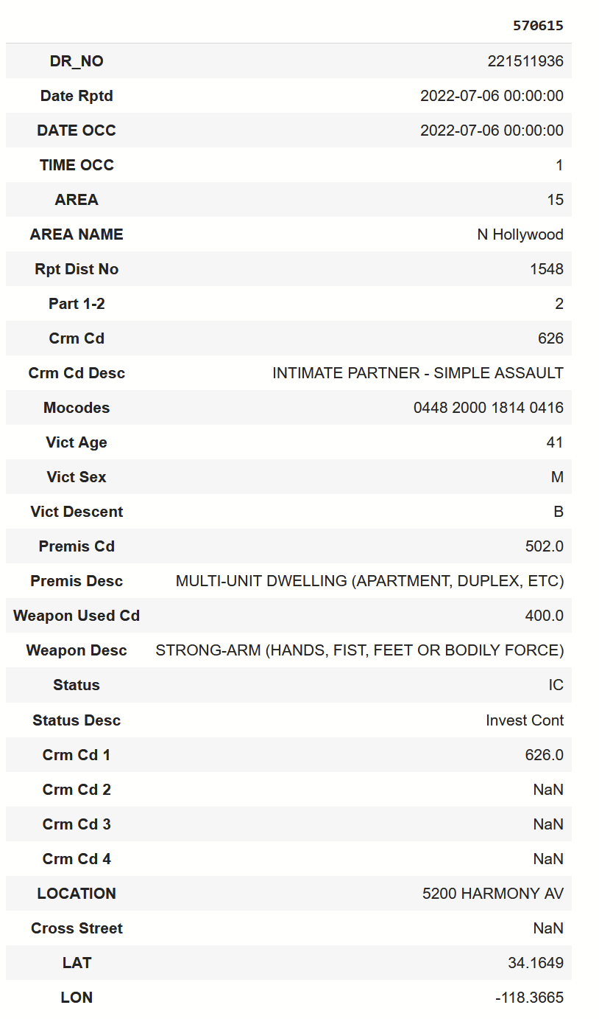
Raw Sample Example
Shrusti Jain, Kevin Lu, Taobo Liao, Smeet Patel

Slide 7
Features
Label:
Type of crime
Crime severity (part 1 or 2)
Input features
Date Occurred
Time Occurred
Victim Age
Victim Sex
Victim Descent
Mocodes
Area
Premise Code
District Number
Status
Weapon Involved Code
Shrusti Jain, Kevin Lu, Taobo Liao, Smeet Patel

Slide 8
Missing Data
Multiple features had either null values or values of 0
When there was no human victim, victim age would be 0
Skewed the training data
Premise code had null values
Null values should be one hot encoded
Special handling for values of 0
Shrusti Jain, Kevin Lu, Taobo Liao, Smeet Patel

Slide 9
Feature Conversion
Features chosen were based on available information before a crime
Categorical features were one-hot encoded
e.g. victim sex, victim descent
Codes with no numerical relationship were one-hot encoded
e.g. Mocodes, area code
Label is one-hot encoded for the same reason
Shrusti Jain, Kevin Lu, Taobo Liao, Smeet Patel

Slide 10
Data Imbalance
Mocodes was heavily skewed towards most common codes
Cut down to codes with above 2000 occurrences to avoid imbalance
Also ran into RAM issues with such a large feature set
738 codes -> 138 codes
Crime codes had a similar issue
Grouped together low frequency codes into one “other category”
Shrusti Jain, Kevin Lu, Taobo Liao, Smeet Patel

Slide 11
Time Imbalance
2024 had a severe lack of data compared to years 2020-2023
Decided to only use years 2020-2023 for our main baseline and deep learning attempts
Refer to slide __ for feature importance of date occurred
Refer to slide 20 for evaluations on time imbalance data
Shrusti Jain, Kevin Lu, Taobo Liao, Smeet Patel

Slide 12
Baseline Learning
Shrusti Jain, Kevin Lu, Taobo Liao, Smeet Patel

Slide 13
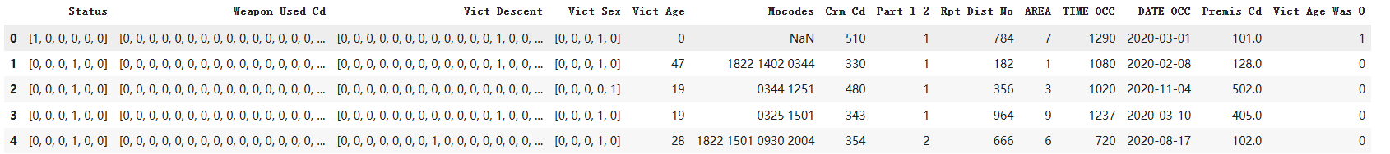
Baseline Learning
Sample data points (with one-hot encoding)
Shrusti Jain, Kevin Lu, Taobo Liao, Smeet Patel

Slide 14
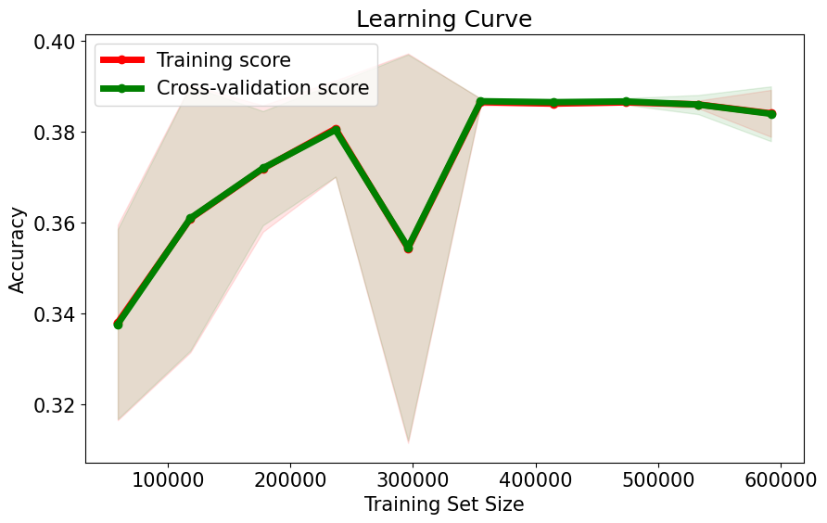
Baseline Learning Result
Ridge classifier
Linear classifier with L2 regularization
Reached about 39% accuracy
Shrusti Jain, Kevin Lu, Taobo Liao, Smeet Patel

Slide 15
Deep Learning
Shrusti Jain, Kevin Lu, Taobo Liao, Smeet Patel

Slide 16
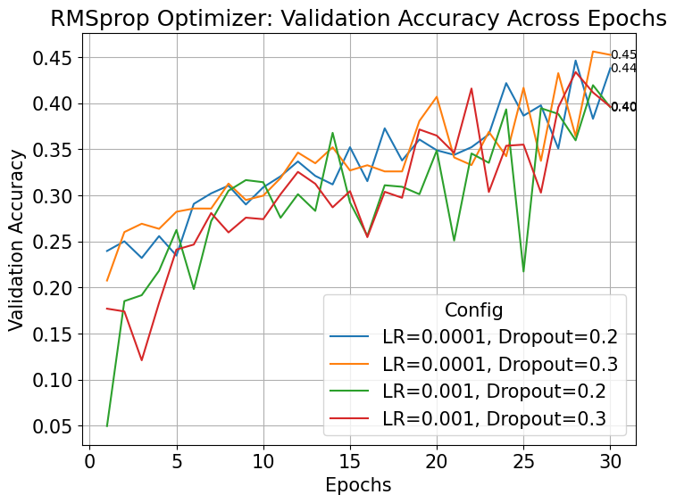
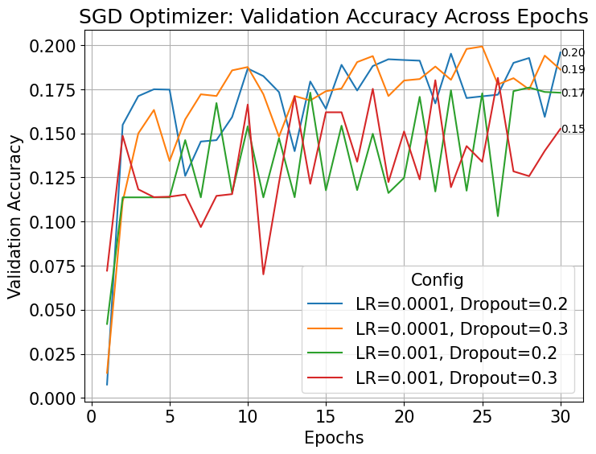
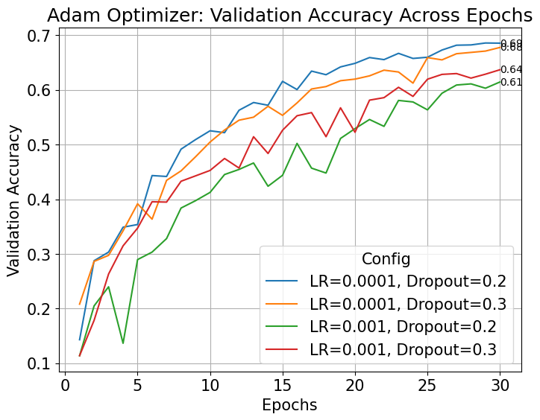
Best optimizer and tuning hyper-parameters
Shrusti Jain, Kevin Lu, Taobo Liao, Smeet Patel

Slide 17
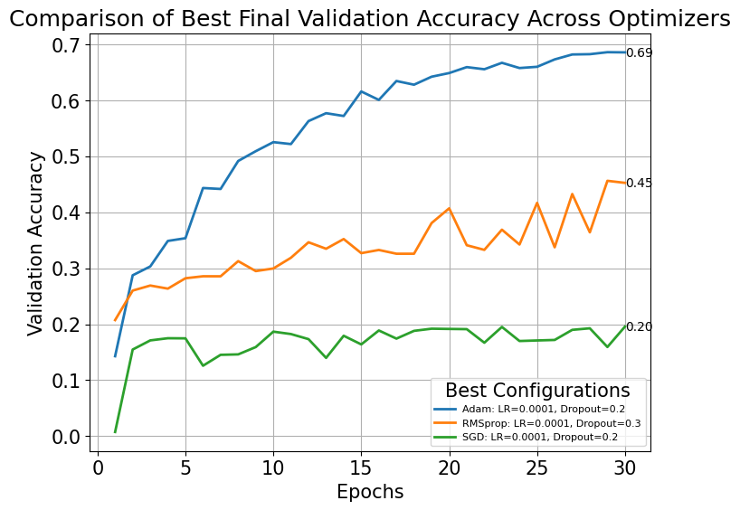
Comparison of different optimizers

Slide 18
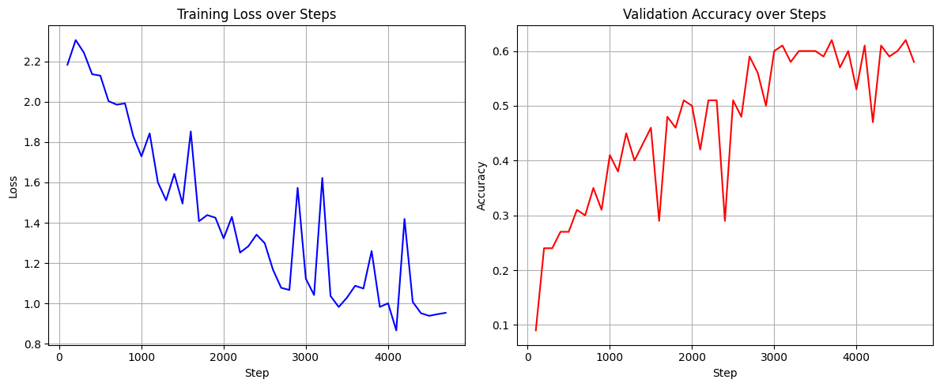
Deep Learning
Results

Slide 19
Part 1-2
What is Part 1 or 2 crime?
Training with Part 1 or 2 crime as target
Accuracy: .93 on test set
Feature Importance
Shrusti Jain, Kevin Lu, Taobo Liao, Smeet Patel

Slide 20
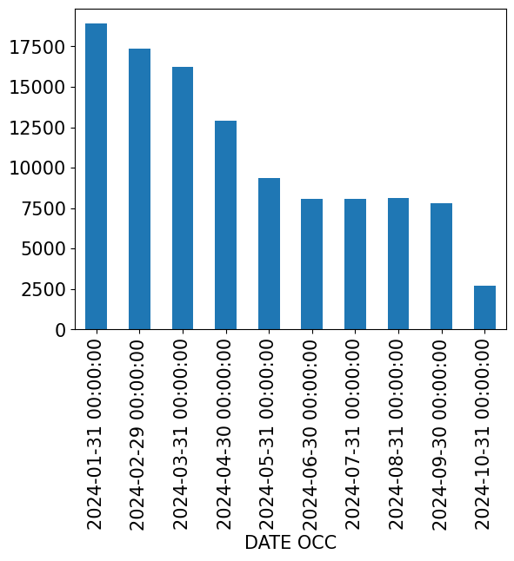
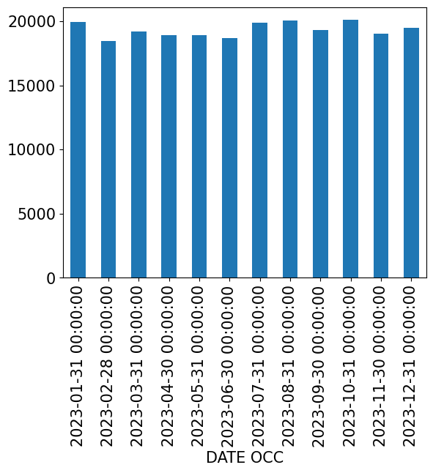
Time-Sensitive Learning
Training on 2020-2022 data, “validating” on 2023, testing on 2024
Accuracy: .62 on 2023, .46 on 2024
Data bias
Feature Importance
Shrusti Jain, Kevin Lu, Taobo Liao, Smeet Patel

Slide 21
Feature Importance
Shrusti Jain, Kevin Lu, Taobo Liao, Smeet Patel

Slide 22
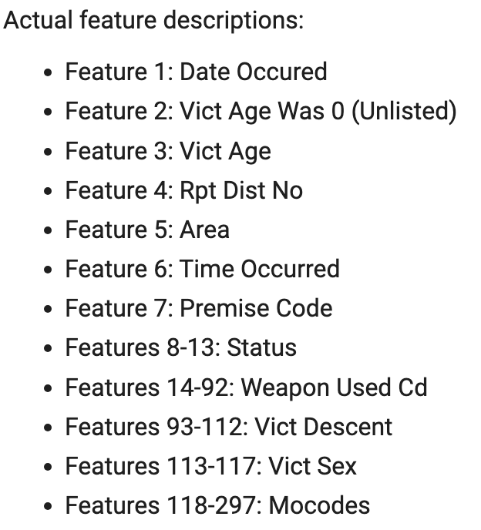
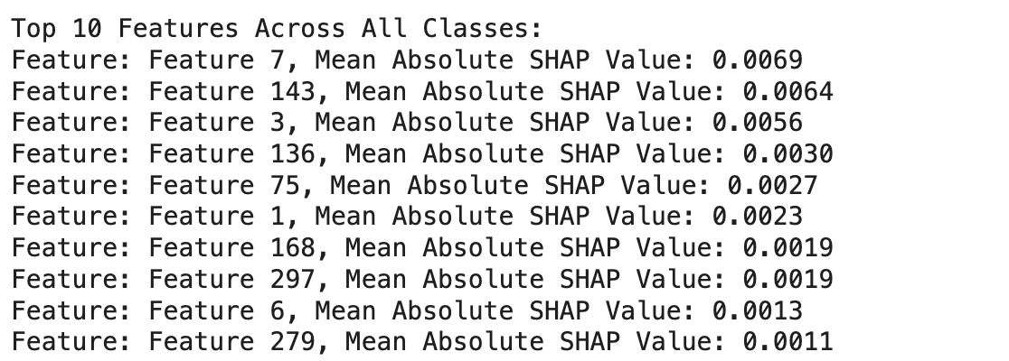
Per Feature Importance Results
Top 10 most important features
Single type features (features with one column) contribute more to the predictions.
Some features in Mocodes (feature 118-297) are still important even though Mocodes include 180 different types of features.
Shrusti Jain, Kevin Lu, Taobo Liao, Smeet Patel

Slide 23
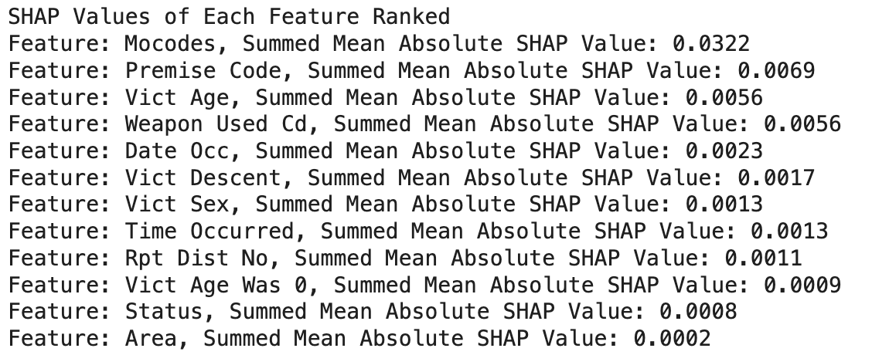
Grouped Feature Importance Results
Rankings of feature importance per group
groups are comprised of their respective one-hot encodings
results are a summation of Shapley values
Shrusti Jain, Kevin Lu, Taobo Liao, Smeet Patel

Slide 24
Conclusions

Slide 25
Conclusion (Features/Results)
Baseline learning showed that deep learning was necessary for accuracy predictions
39% accuracy vs Deep Learning 68% accuracy
Mocodes, descriptors of the environment before the crime, are by far the most important features in prediction
Is also the largest group of features
Per feature importance shows that Premise Code, Victim Age, Date/Time occured are most important
Shrusti Jain, Kevin Lu, Taobo Liao, Smeet Patel

Slide 26
Conclusion (Restrictions)
Limited dataset
Features available
Feature imbalance
Time imbalance
Only includes information when crime occurs
Limited GPU usage and RAM availability
Shrusti Jain, Kevin Lu, Taobo Liao, Smeet Patel

Slide 27
Conclusion (Future Work)
Cross referencing with other datasets
Weather, income, unemployment rates, traffic
Including data where crime doesn’t happen
Stronger GPU and more RAM
Expanding the model to an RNN
Predict evolution of crime over a time-period
Real-time predictions
Leveraging modern IoT systems
Shrusti Jain, Kevin Lu, Taobo Liao, Smeet Patel

Slide 28





































Icon Set

